Slide 1
SIMPLE BANKING MANAGEMENT SYSTEM
NIKHITHA N(111720201026)
VARSHITHA REDDY M(111720201023)
DEPARTMENT OF ARTIFICIAL INTELLIGENCE AND DATA SCIENCE

Slide 2
ABSTRACT
The design and development of this bank management
provides a more secured approach
The Bank Account Management System is an application for maintaining a person's account in a bank.
This handles the overall tasks going without much effort.
No need to maintain the manual records for years and years
Developed using HTML CSS Python and MYSQL
Crediting, debiting, checking balance and retrieving history can be done easily

Slide 3
OBJECTIVE & SCOPE
4.1
03
The scope of the Bank Management System extends to all the users who wish for easy banking facilities.
01
04
The main aim of designing and developing this Internet banking System using Python
02
To improve customer service, organizational culture in friendly manner.
02
03

Slide 4
EXSISTING SYSTEM
Time Consuming
In bank, for doing transactions a lot of time will be wasted
Reliability
not fully reliable because sometimes our data is damaged or lost.
Man Power
man power is fully used. A number of employees are needed to manage the data.
Less Accurate
As you are using man power there is a lot of possibility for mistakes.

Slide 5
Proposed System
Very Fast and accurate results
Efficient
Very secure and data can’t be corrupted or mishandled easily
Secure
User details can be updatable effortlessly
updatable
No in-person banker relationship
Man-power

Slide 6
Technology Used
CSS
HTML
Python
MYSQL

Slide 7
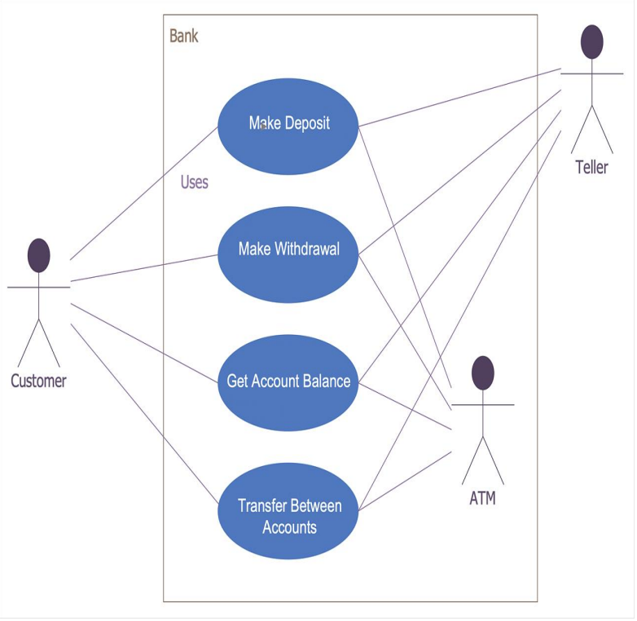
Use Case Diagram

Slide 8
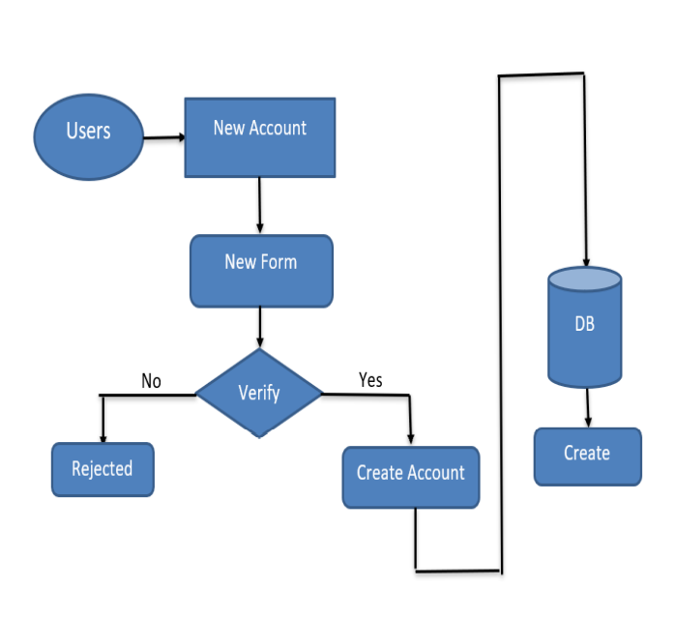
Data Flow Diagram
For creating an account

Slide 9
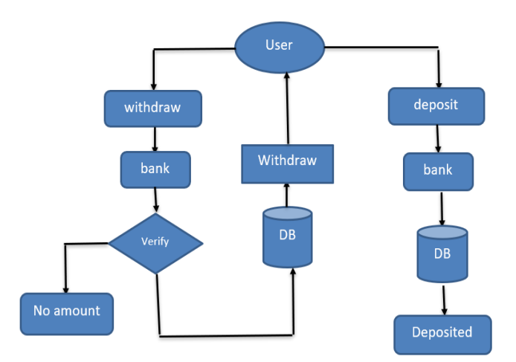
For crediting and depositing

Slide 10
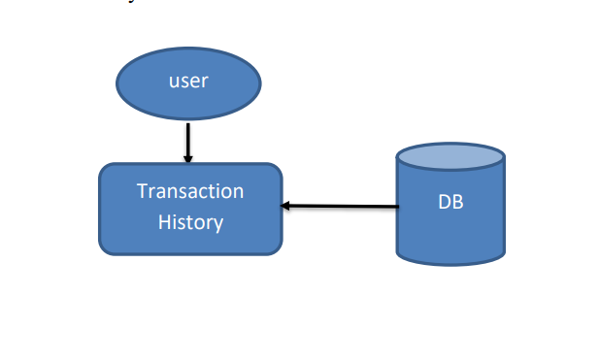
For Transaction History

Slide 11
Future Enhancement
Loan Feature
Loan can be taken through website
Face Recognition
Multiple accounts
A better authentication technique to access website
Able to manage multiple accounts simultaneously

Slide 12
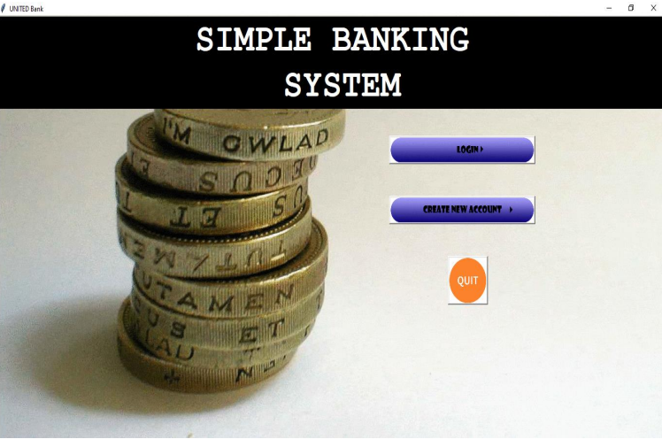
Screenshots

Slide 13
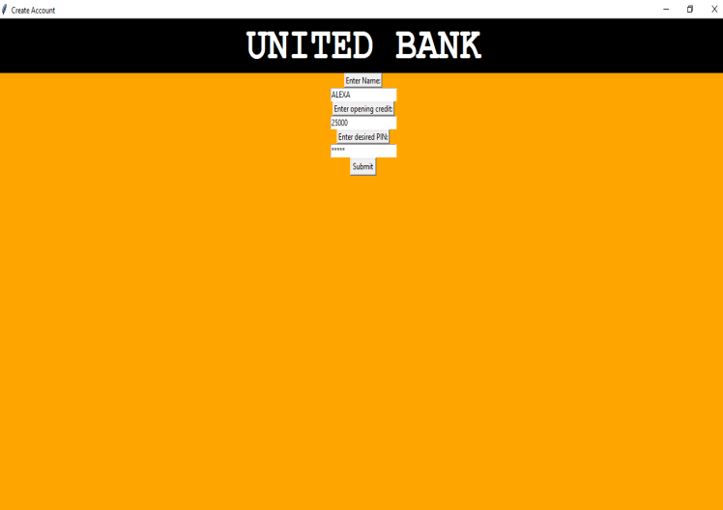

Slide 14
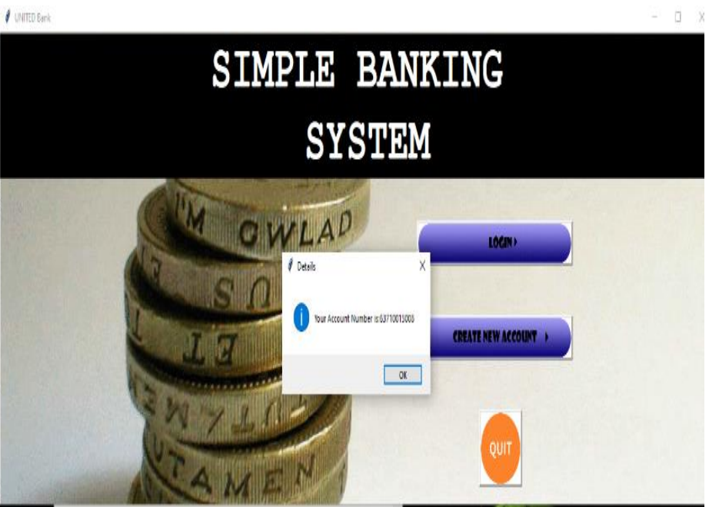

Slide 15
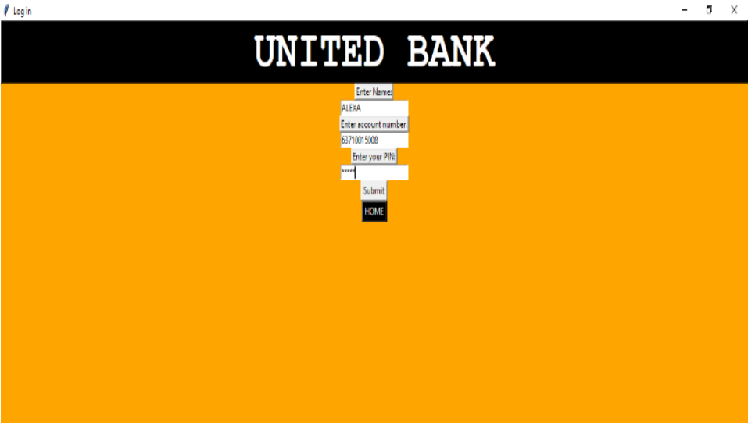

Slide 16
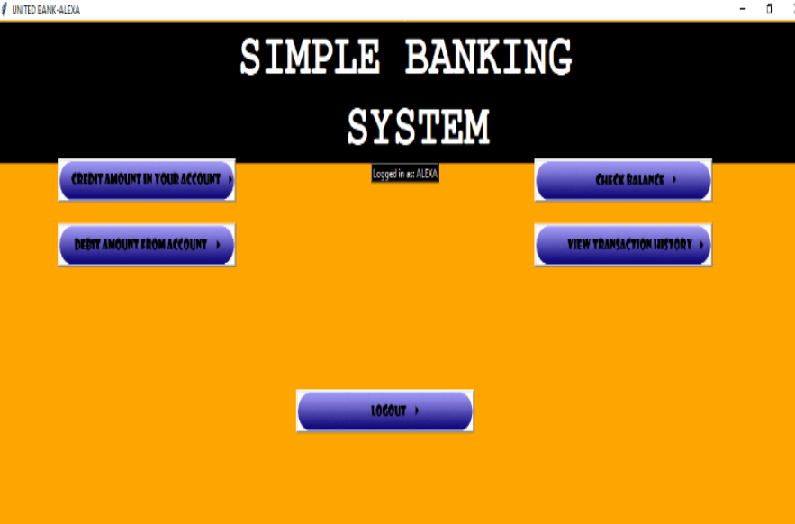

Slide 17


